Slide 1
Database Management System
Lecture # 11-12

Slide 2
Create Table
The CREATE TABLE statement is used to create a new table in a database.
In that table, if you want to add multiple columns, use the below syntax.
CREATE TABLE table_name
(
column1 datatype,
column2 datatype,
column3 datatype,
....
);
The column parameters specify the names of the columns of the table.
The data type parameter specifies the type of data the column can hold (e.g. varchar, integer, date, etc.).

Slide 3
Create Table
Create Table Example
CREATE TABLE Employee(
EmpId int,
LastName varchar(255),
FirstName varchar(255),
Address varchar(255),
City varchar(255)
);
The EmpId column is of type int and will hold an integer.
The LastName, FirstName, Address, and City columns are of type varchar and will hold characters and the maximum length for these fields is 255 characters.

Slide 4
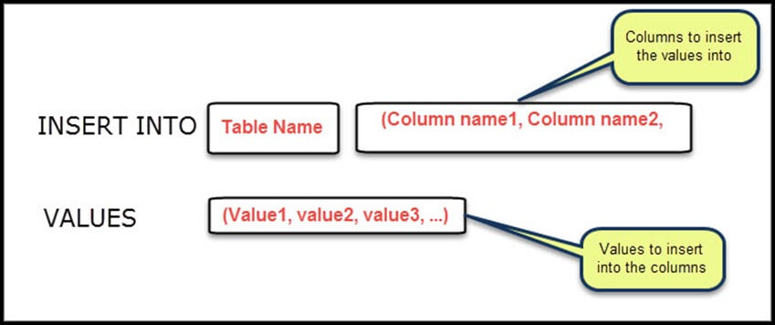
INSERT INTO GENERAL SYNTAX

Slide 5
INSERT INTO statement
The INSERT INTO statement is used to insert new records in a table.
After the INSERT clause, you should state which table you need to insert the values into.
After the table name you write the list of columns, you want to insert the values into.
You can ignore the columns name and don't write to them.

Slide 6
INSERT INTO statement
If you don't write the columns name, the values will be inserted into all the columns found in the table with the same order, the columns are defined in the table.
After the VALUES clause, you should list the values to be inserted.
Each INSERT clause inserts only one row. If you want to insert multiple rows, you should write multiple INSERT clauses, one for each row.

Slide 7
INSERT INTO statement
It is possible to write the INSERT INTO statement in two ways.
Syntax
The first way specifies both the column names and the values to be inserted.
If you are adding values for all the columns of the table, then no need to specify the column names in the SQL query. However, make sure that the order of the values is in the same order as the columns in the table.

Slide 8
INSERT INTO statement
‘Ist Way’
INSERT INTO table_name (column1, column2, column3, ...)
VALUES (value1, value2, value3, ...);
'2nd way’
INSERT INTO table_name
VALUES (value1, value2, value3, ...);

Slide 9
INSERT INTO statement Example
Insert value in a 1st way. The column names are used here
INSERT INTO Employee (EmpId,LastName,FirstName,ADDRESS,City)
VALUES (1, 'XYZ', 'ABC', Pak', ‘Isb' );
INSERT INTO Employee (EmpId,LastName,FirstName,ADDRESS,City)
VALUES (2, 'X', 'A', ‘Pak', ‘Lhr' );
Insert value in a 2nd way.
INSERT INTO Employee
VALUES (3, 'XYZ', 'ABC', ‘Pak', ‘Khi' );

Slide 10
INSERT INTO statement Example
A variation of INSERT allows several comma-separated records to be inserted at once as follows:
INSERT INTO table_name (field1, field2, ...)
VALUES (value3, value4, ...),
(value5, value6, ...),
(value7, value8, ...);

Slide 11
UPDATE statement
The UPDATE statement is used to modify the existing records in a table.
You can use WHERE clause with UPDATE query to update selected rows.
The UPDATE clause updates a table by changing a value for a specific column.

Slide 12
UPDATE statement
After the "update clause", you should write the table name to update.
You have to write "SET clause" which is used to write the column name to update and the value to be updated.
You can update more than one column. You can use a comma between each line.
You can specify a WHERE clause to specify some rows only. Only the rows that the expression evaluates to true are updated.
If you didn't specify a WHERE clause, all the rows will be updated

Slide 13
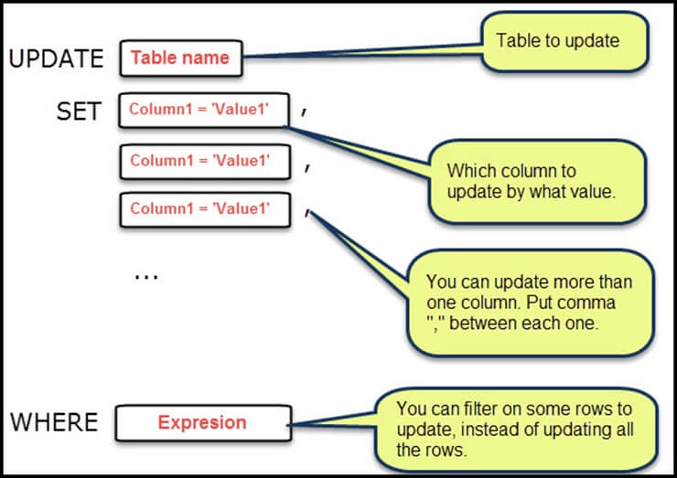
UPDATE GENERAL SYNTAX

Slide 14
UPDATE statement
Syntax
UPDATE table_name
SET column1 = value1, column2 = value2, ...
WHERE condition;
Example
UPDATE Employee
SET FirstName= ‘XYZ', City= ‘Isb'
WHERE EmpId= 1;

Slide 15
UPDATE statement
If the above query is executed then for EmpId= 1, "Firstname" and "City" column data will be updated.
Update Multiple Rows
It is the WHERE clause that determines how many records will be updated.
UPDATE Employee
SET City=‘Isb’

Slide 16
DELETE statement
The DELETE statement is used to delete existing records in a table for a particular Record.
You can use the WHERE clause with DELETE queries to delete the selected rows.

Slide 17
DELETE statement
The DELETE statement is used to delete existing records in a table for a particular Record.
You can use the WHERE clause with DELETE queries to delete the selected rows.
You have to write a table name after the DELETE FROM clause, from which you want to delete records.
Note: that the DELETE clause is used to delete some records from a table or delete all the records and it won't delete the table itself.
However, the DROP clause is used to delete the entire table with all the records on it.)

Slide 18
DELETE statement
If you write the DELETE clause like this "DELETE FROM Emp", this will delete all the records from the table “Emp".
You can specify a WHERE condition with an expression if you want to delete some specific rows. Only the rows for which the expression evaluates to true will be deleted. For example, "DELETE FROM guru WHERE id > 5" – this will delete only the records that have id larger than 5.

Slide 19
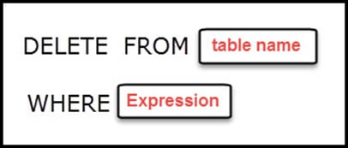
DELETE GENERAL SYNTAX

Slide 20
DELETE statement
Syntax
DELETE FROM table_name WHERE condition;
Example
DELETE FROM Employee WHERE EmpId=1;
In Employee table EmpId = 1 record gets deleted.

Slide 21
DELETE statement
Delete All Records
It is possible to delete all rows in a table without deleting the table. This means that the table structure, attributes, and indexes will be intact,
DELETE FROM table_name;
Example
DELETE From Employee ;
When the above query is executed, only table Data gets deleted.

Slide 22
Thanks

